Slide 1
CMSC 304
Introduction to Python
Claire Sparks

Slide 2
Python
Python is a high level, interpreted, imperative, and object oriented programming language
  Technically a multi-paradigm language but we’re focusing on the imperative / OO elements
Python fits into some of the same language paradigms as Java
  Thus the languages behave in very similar ways
Python 2 was sunset in 2020 and is significantly different from Python 3
  Solutions which work in Python 2 will most likely not work in Python 3

Slide 3
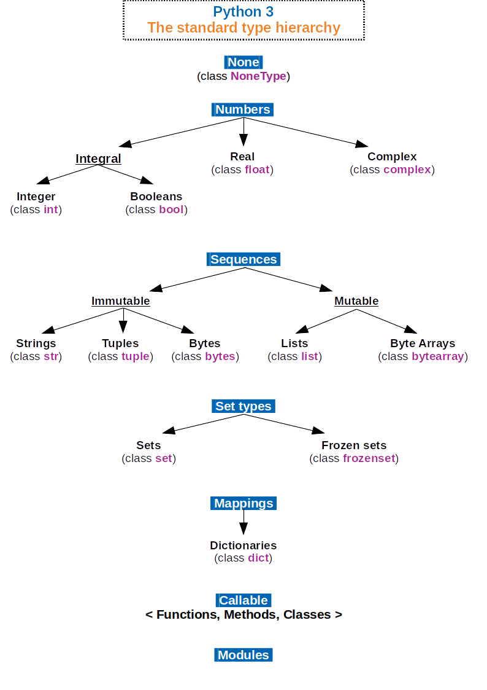
Python Data Types
All data types are objects
Python has several built-in data types:
None
  Python equivalent of null
Numeric types:
  int: Integers; non-limited length
  bool: True / False
  float: Floating-Point numbers, equivalent to Java doubles
  complex: Complex numbers
Notes:
All these built in data types are objects
Contrast this with Java’s messy Primitive vs Reference type nonsense

Slide 4
Python Data Types
Sequences:
  str: String; represented as a sequence of Unicode characters (in the range of U+0000 - U+10FFFF)
  list
  tuple (immutable list)
  byte & bytearray
Sets:
  set: an unordered collection of unique objects
Mappings:
  dict: Python dictionaries, also called hashmaps or associative arrays, which means that an element of the list is associated with a definition, rather like a Map in Java
  Unordered set of key: value pairs

Slide 5
Mutable vs. Immutable Objects
Most objects in Python are immutable and cannot be changed once they are created.
Some immutable types | Some mutable types
int, float, complex, bool str bytes tuple | list set dict

Slide 6
Python Basics
Python utilizes white space
  Statements must be properly indented
  Classes and code blocks are denoted by : and are indented
Statements are executed line by line
  No defined entry point ("Main method") like in Java or C
Each item in Python is an object with a unique identifier
  This includes functions
# denotes a comment
No multiline comment
  """ denotes a documentation String and can be incorrectly used as a multiline comment

Slide 7
Dynamic Typing
Python is dynamically typed
num = 3
num = “Hello”
num is not an object, it is a name
First statement we create an integer object with the value of 3 and bind the name ‘num’ to it
Second statement we create a new string object with the value of “Hello” and rebind the name ‘num’ to it. If there are no other names bound to the first object, then it will be garbage collected
Type is associated with the object, not with the name
Pass around references but don’t check the type until runtime
Notes:
Python is considered

Slide 8
Python Assignment Statements
Allows multiple assignments
  x = 5
  y = 4
  x, y = y, x
  print(x) #4
  print(y) #5

Slide 9
Lists & Tuples
In Python, lists are:
  Ordered and accessed by index
  Mutable
  Able to hold objects of arbitrary type
  Able to hold objects of different types
  Dynamically sized
Tuples are similar to lists but possess some key differences
Tuples:
  Are immutable
  Support sequence packing and unpacking
  Support access by attribute

Slide 10
Lists & Tuples
List objects in Python are mutable and can be changed
Example of a Mutable List Object:
listA = ["John", "Jane"];
tupleB = (listA, 1, "two" );
listA[0]="James"
print(listA) # prints ['James', 'Jane']
print(tupleB) # prints (['James', 'Jane'], 1, “two”)
tupleB[0][0]="John"
print(listA) # prints ['John', 'Jane']
print(tupleB) # prints (['John', 'Jane'], 1, “two”)
#tupleB[1]=3 # prints error, tuple is immutable
Notes:
Lists are:
Ordered and accessed by index

Slide 11
Lists & Tuples
List operations:
listA = ["Hello",2,"World"]
print(len(listA)) #prints 3
listA.remove(2)
listA.insert(1,"Wonderful")
listA.append("!")
print(listA) #prints ['Hello', 'Wonderful', 'World', '!']
print(listA.pop(len(listA) -1)) #prints !
print(listA) #prints ['Hello', 'Wonderful', 'World']
Notes:
Lists are:
Mutable
Able to hold objects of arbitrary type
Able to hold objects of different types
Dynamically sized

Slide 12
Lists & Tuples
Tuple operations:
v = (8,9,10)
print(v) # prints (8, 9, 10)
x,y,z = 1,2,3
w = x,y,z
print(w) # prints (1, 2, 3)
a,b,c = w
print(b) # prints 2
Notes:
Tuples:
Are immutable
Support sequence packing and unpacking

Slide 13
Python Demo

Slide 14
Python Basics
Id(object) returns the identity of the object
  an integer that is unique and constant for this object during its lifetime
Objects with non-overlapping lifetimes can have same id() value
  new = 45
  old = 45
  x = new
  a = 34
  print(id(new)) # 1750060080
  print(id(old)) # 1750060080
  print(id(x)) # 1750060080
  print(id(a)) # 1750059728
Notes:
This happens because Python is trying to save memory here
It works because most objects are immutable

Slide 15
Looping in Python
Python provides two looping structures: the for loop and the while loop
The while loop in Python is a standard event controlled loop
  while True:
  print("stop")
The for loop structure in Python is similar to the for each loop in Java
  There is no traditional for loop equivalent in Python
The Python for statement iterates over the members of a sequence in order
  for aValue in myList:
  print(aValue)
Notes:
Control-C can be used as an escape sequence in the python environment

Slide 16
Looping in Python
Although there is no traditional for loop in Python we can emulate its behavior using the range function
range is technically a constructor which takes a start and stop value and returns a range object
A third optional parameter, step, specifies the difference in value between two elements in the range
  The default value for step is 1
The advantage of the range type over a regular list or tuple is that a range object will always take the same (small) amount of memory, no matter the size of the range it represents
  It only stores the start, stop and step values, calculating individual items and subranges as needed
Notes:
r[i] = start + step*i where i >= 0 and r[i] < stop

Slide 17
Looping in Python
listA = ["Hello",2,"World"]
for x in listA:
print(x)
for x in range(0, 3):
print("We're on iteration %d" % (x))
Notes:
The range function returns a list from x to y, x is included, y is not

Slide 18
Looping in Python
Another limitation of the foreach loop is the inability to modify the collection being iterated over
The limitation can be overcome using the enumerate function
foo = ["Hello","World","Element"]
bar = ["Other","Unknown","Data"]
for index,element in enumerate(foo):
if "World" in element:
foo[index] = bar[index]
print(foo)
# ['Hello', 'Unknown', 'Element']

Slide 19
Working Through Lists & Tuples
Going through elements in a loop
  len(x) returns length of list/tuple
  range(N) allows us to go through 0,…,N-1
  Slicing allows us to get a subset of a list/tuple
  Slicing [start:end:step]
  from start
  to (but not including) end
  step – how many are skipped each time

Slide 20
Working Through Lists & Tuples
listB = [1,2,3,4,5,6,7,8,9,10]
print(listB[slice(0,9,3)]) #[1, 4, 7]
print(listB[0:9:3]) #[1, 4, 7]
print(listB[3:5:]) #[4, 5]
print(listB[:5:]) #[1, 2, 3, 4, 5]

Slide 21
Slice vs Range
In Python, ranges and slices are very similar
  Both conform to the start, stop, and step design pattern
Subtle differences between the two
  Range objects are iterable and slice objects are not
  Slices can be used as indices, ranges can not
  You can slice a range but you can not range a slide

Slide 22
Working Through Lists & Tuples, cont.
Examples
print("list") # list
l=['d','c','b','a'] d
for char in l: c
print(char) b
a
print("tuple") # tuple
t=('d','c','b','a') d
for char in t: c
print(char) b
a
print("range") # range
for idx in range(len(t)): d
print(t[idx]) c
b
a
print("slice") # slice
for char in l[0:4:2]: d
print(char) b

Slide 23
Functions
Python functions:
  are defined using the def keyword
  Support multiple return values
    Like multiple assignment, when multiple values are returned they are stored in a single tuple and that tuple is returned
  Support default arguments, keyword arguments, and variable length arguments
  Do not support function overloading (the internet is lying!!!)
Function arguments are passed by value
def foo(x, y):
return x,y
def bar(a, b = 2):
return a+b

Slide 24
Python Demo

Slide 25
Python Scoping
A variable is either global or local throughout the whole function
x=10
def whatsX1():
y=x
return x+y
print(whatsX1()) # Prints 20
x=10
def whatsX2():
y=x
x=3
return x+y
print(whatsX2())
#UnboundLocalError: local variable 'x' referenced before assignment

Slide 26
Python Scoping
A variable is either global, or local, throughout the whole function
x=10
def whatsX1():
global x
y=x
x=3
return x+y
print(whatsX1()) # Prints 13
print(x) # Prints 3
x=10
def whatsX2():
y=x
global x
x=3
return x+y
print(whatsX2())
#SyntaxWarning: name 'x' is used #prior to global declaration #global x

Slide 27
List Comprehensions
Tool for transforming an iterable into another iterable
  Elements can be both transformed and conditionally included
List comprehensions are composed of four parts:
  The result
  The transformation
  The collection
  The conditional
foo = [1,2,3,4,5,6,7,8,9,10]
doubled_odds = [n * 2 for n in foo if n % 2 == 1]
print(doubled_odds)
#[2, 6, 10, 14, 18]

Slide 28
List Comprehensions
List comprehensions are composed of four parts:
  The result
    Variable assignment for resulting collection
  The transformation
    Expression being appending to resulting collection
  The collection
    Collection being iterated over
  The conditional
    Conditional determining if current element should be transformed and appended
    The conditional is an optional component

Slide 29
List Comprehensions
List comprehensions work on any iterable
doubled_odds = [n * 2 for n in range(1,11,2)]
List comprehensions can preform nested iteration
We can use list comprehensions to flatten a 2D collection
bar = [(1,2),(3,4),(5,6)]
result = [y for x in bar for y in x]

Slide 30
Python Modules
Modules are files containing Python definitions and statements
  The file name is the module name with the suffix .py appended
With the module, the module’s name as a string is available as the global variable __name__
  Ex: import math
  math.__name__ # returns "math"
Modules can import other modules. It is customary to place import statements at the beginning of a module

Slide 31
Python Modules
The import function does not enter the names of the functions defined in the module directly in the current symbol table. It only enters the module name there. Using the module name you can access the functions
Ex: import geometry #Only geometry is imported
    pt = geometry.Point(10, 20) #Use geometry to access
    print(pt) functions within module
There is a variant to the import statement that imports function names from a module directly into the importing module’s symbol table
Ex: from geometry import Point
You could also use: from geometry import *
  (not suggested since it is unknown what you are importing)

Slide 32
Python Modules
Modules can also contain executable statements that are intended to initialize the module. They are executed only the first time the module name is encountered in an import statement.
You can run a Python module with the code:
  Python geometry.py <arguments>
  The code in the module will be executed, just as if you imported it, but with the __name__ set to "__main__".

Slide 33
Python Modules
In a program that can be either run stand-alone or loaded as a library, the call to main at the bottom should be made conditional, e.g.
if __name__ == '__main__':
main()
This means that you can make the file usable as a script as well as an importable module because the code that parses the command line only runs if the module is executed as the "main" file

Slide 34
Python Demo

